Slide 1
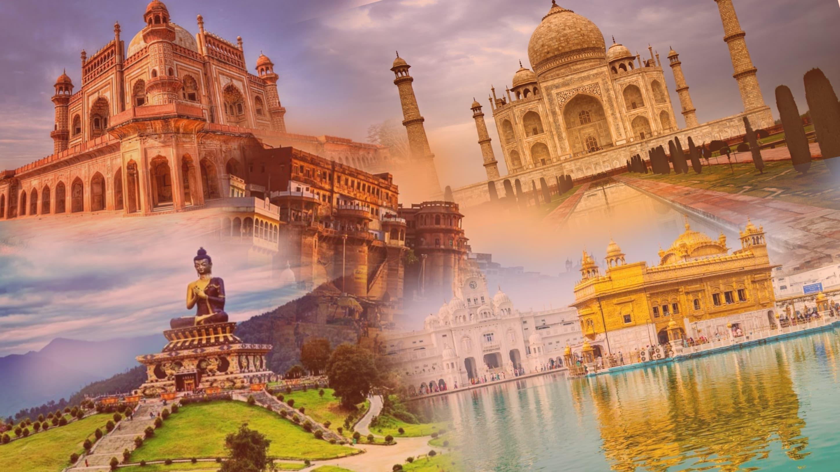
EXPLORE INDIA
“ India is a tapestry of vibrant cultures, timeless traditions, and breathtaking landscapes. Exploring its wonders is a journey of discovery, where every step unveils a new story, and every encounter leaves a lasting impression ”

Slide 2
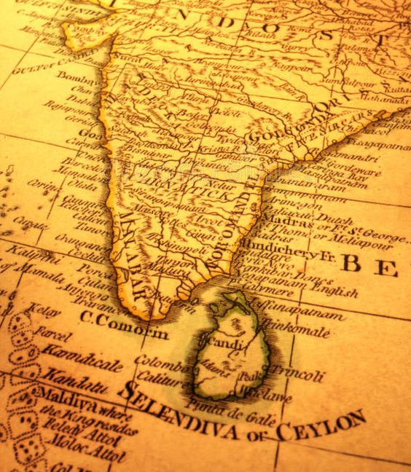
AIM OF MY WEBSITE :-
Inspiration for Travel: The website aims to inspire travel enthusiasts by sharing unique experiences, hidden gems, and off-the-beaten-path destinations.
Travel Guides & Tips: It provides comprehensive travel guides and practical tips to help travelers plan their trips effectively.
Cultural Insights: The blog explores local cultures, traditions, and cuisines, offering readers a deeper understanding of the places they visit.

Slide 3
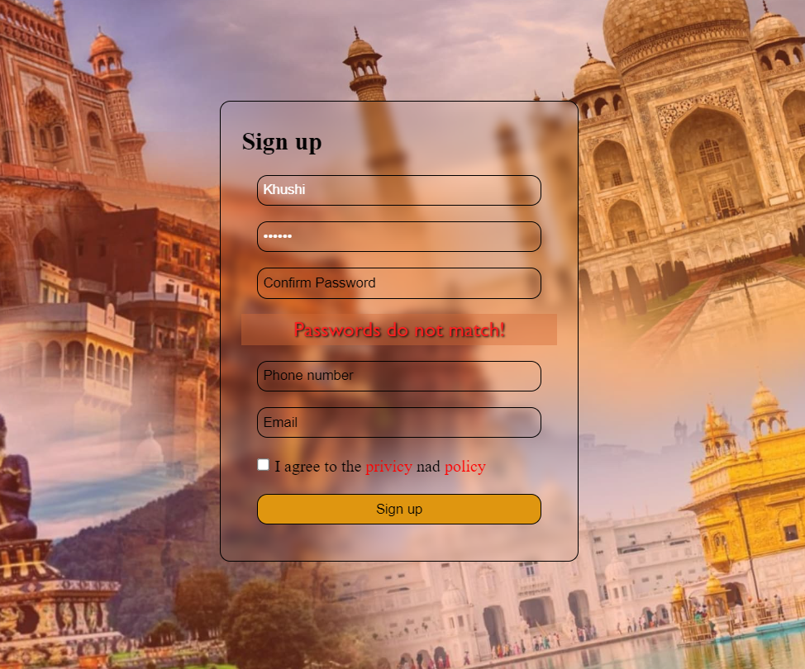
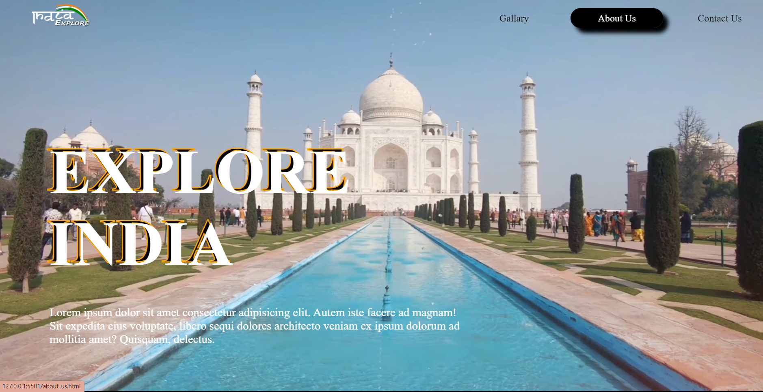
KEY FEATURE :-
Comprehensive Travel Guides: Detailed guides for various destinations, covering essential information like best attractions, accommodations, transportation, and local customs.
Responsive Design: A user-friendly, responsive layout that ensures optimal viewing and navigation on desktops, tablets, and smartphones.
Rich Media Content: High-quality photos, videos, and multimedia elements that enhance the storytelling and visual appeal of the site.
User Registration: Allows visitors to create accounts for enhanced interaction and personalized content.
Mission & Vision: Outlines the blog's purpose, goals, and overarching vision to establish the site's credibility.
Popular Destinations: Highlights the most popular or recommended destinations, enticing visitors to explore further.

Slide 4
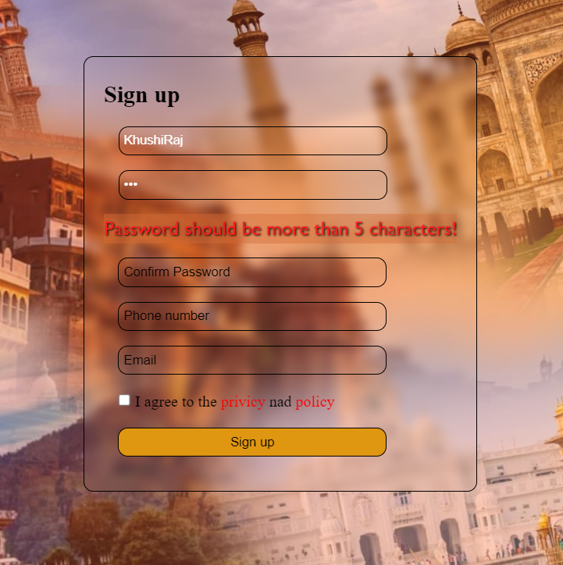
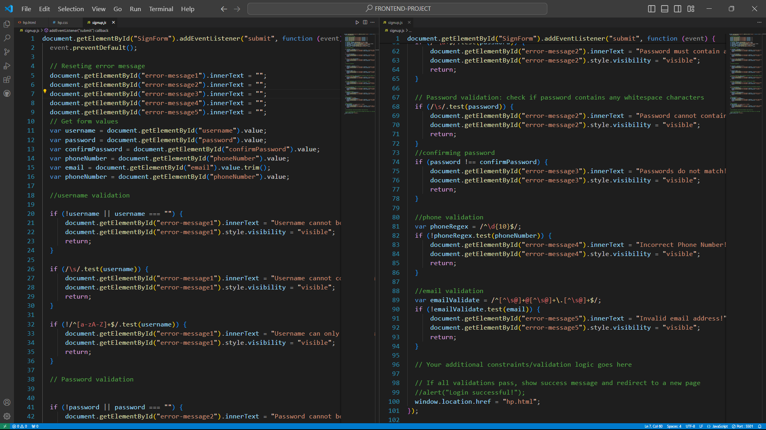
Blog Structure & Navigation
First user have to SignUp to explore the website.
(I have used JavaScript for the form validation)

Slide 5
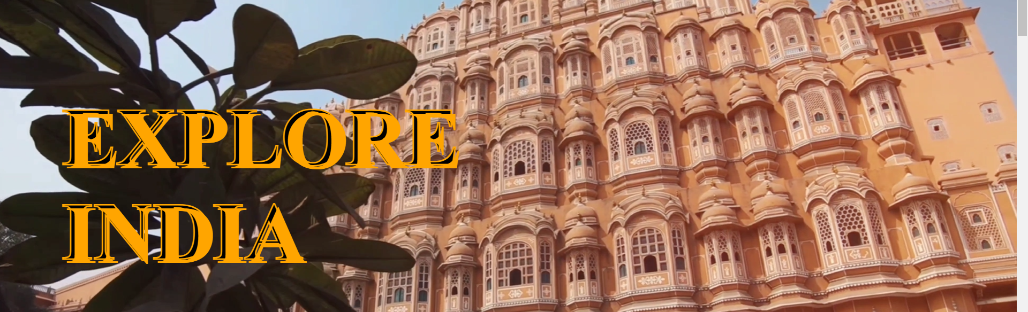
After Signing up successfully ,user will be redirected to my home page of the website.
Which provide lot of feature to engage a user. Such as , Blog section , Top destination , explore and more.

Slide 6
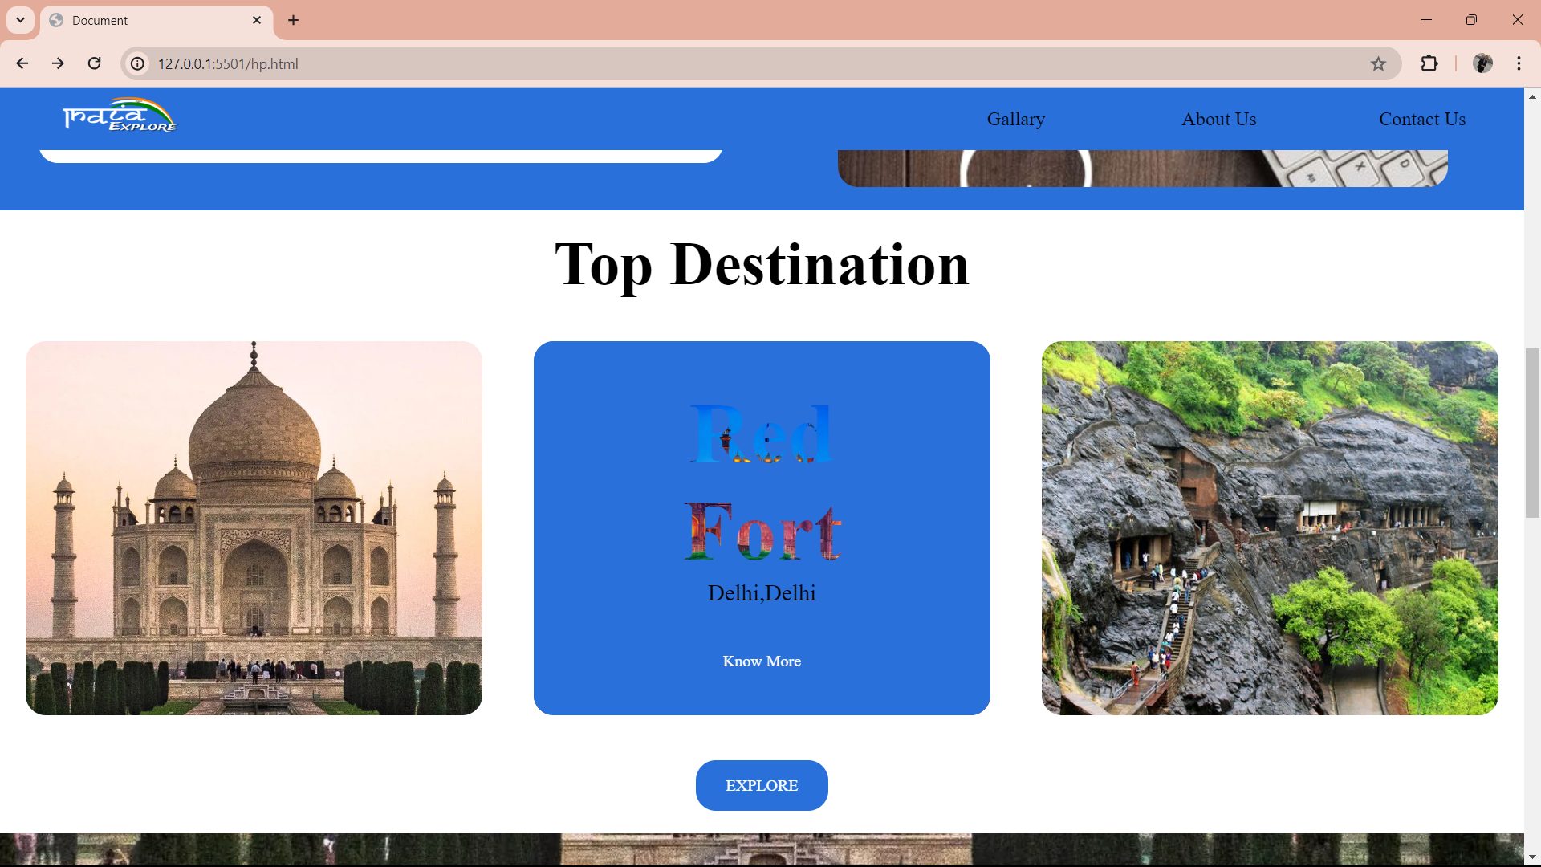
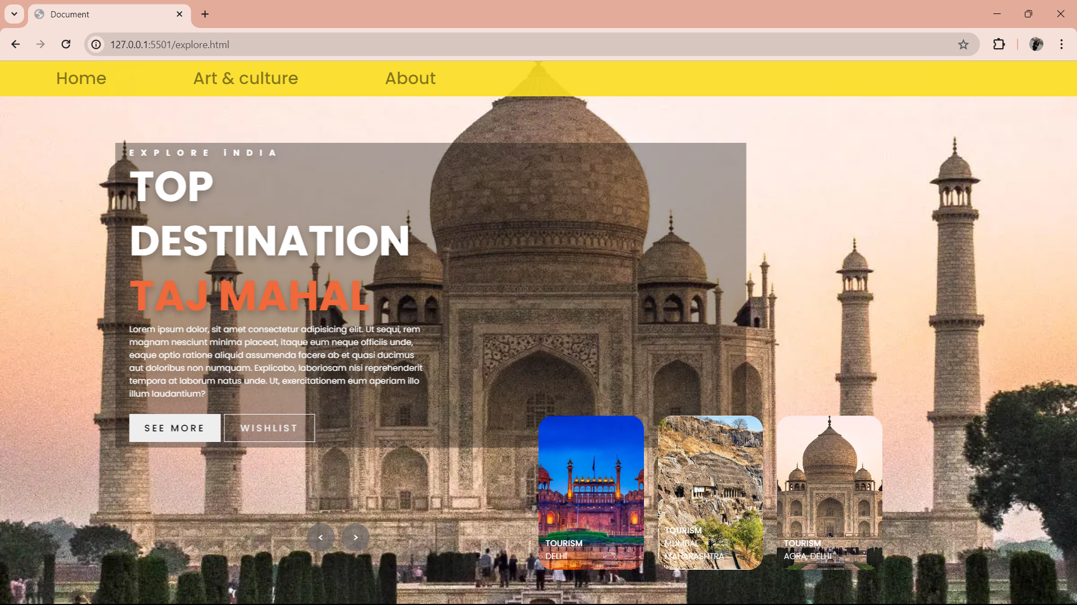
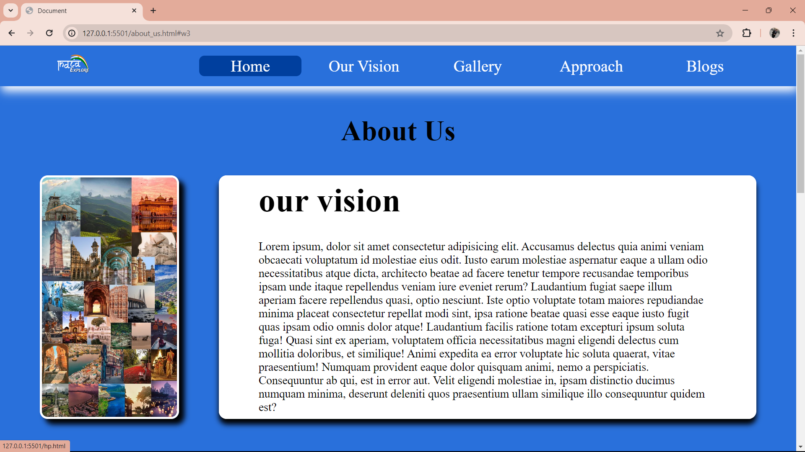
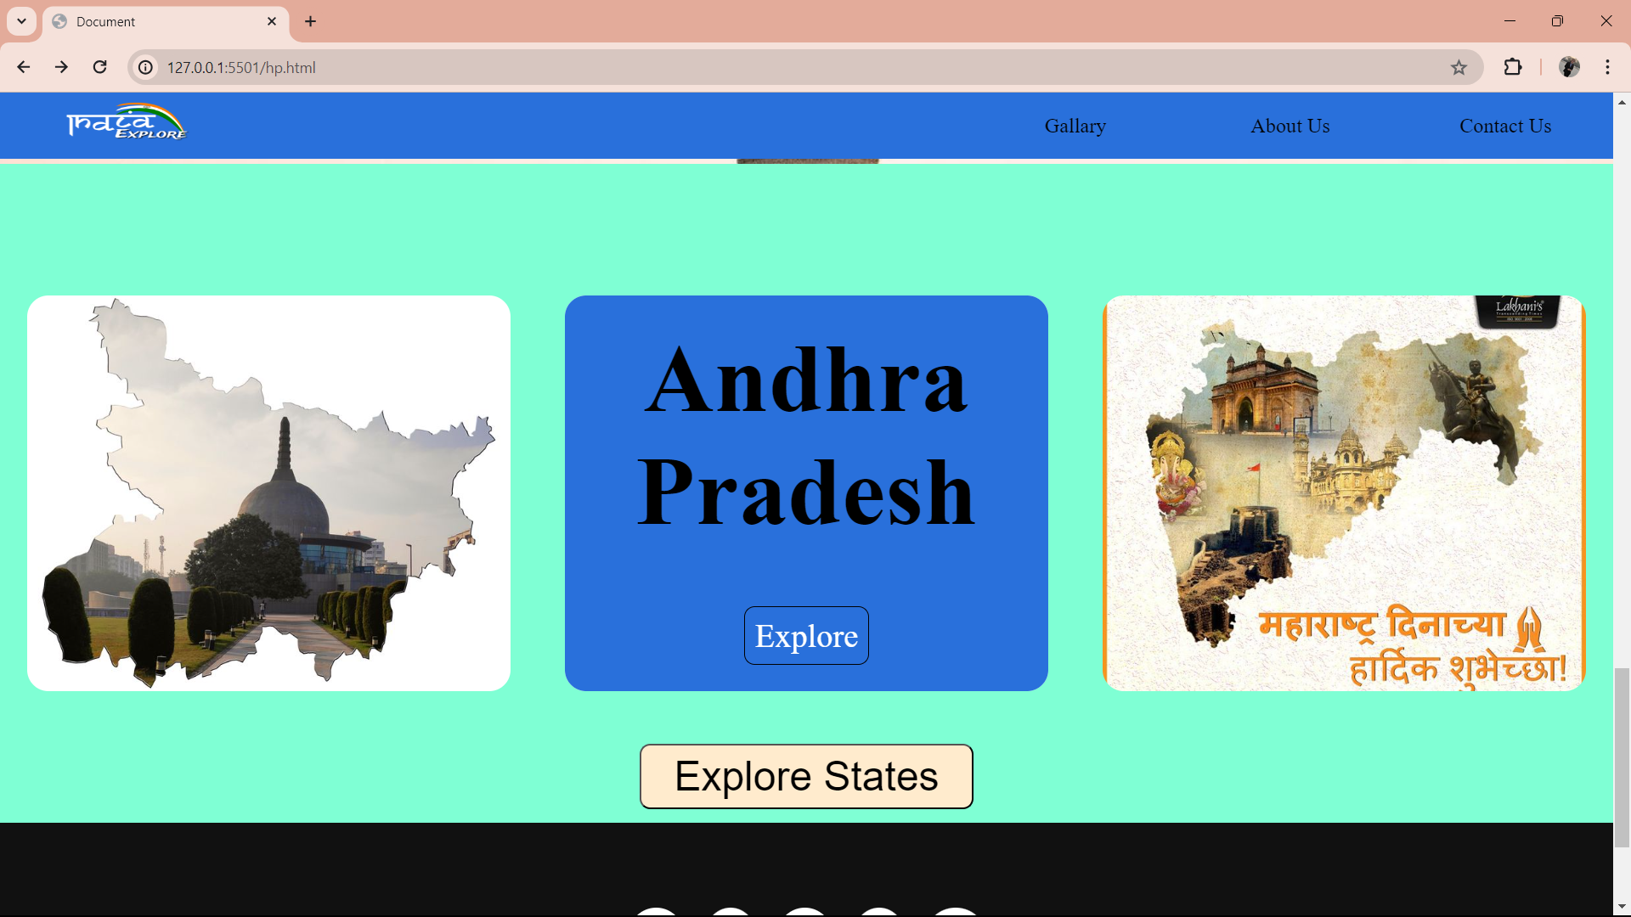

Slide 7
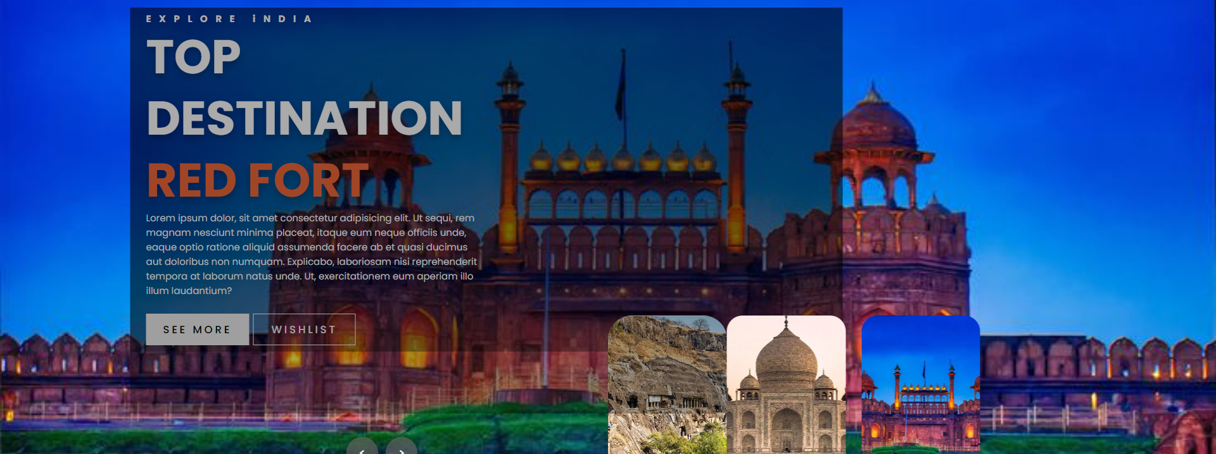
For depicting the various places in a city or state , I have used Sliders & Thumbnail Together .

Slide 8
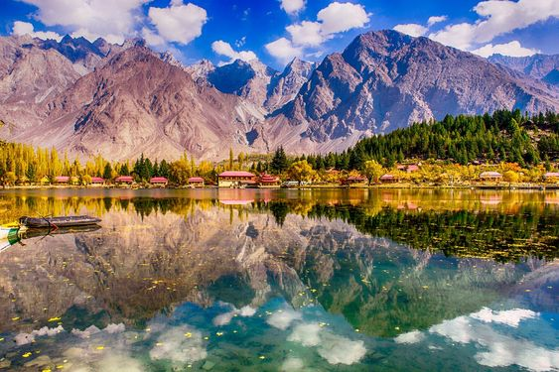
FUTURE GOALS :-
Advanced Search and Filters: Expanding the search capabilities to include more refined filters, allowing users to find content based on specific criteria like location, travel type, or time of year.
User-Generated Content: Introducing a section where users can submit their travel stories, photos, and videos to share with the community.
Local Events and Activities Calendar: Introducing a calendar that highlights local events, festivals, and activities in various destinations, offering travelers more reasons to visit.

Slide 9
GITHUB LINK
https://github.com/KhushiRaj23/Project/tree/master/FRONTEND-PROJECT

